Slide 1

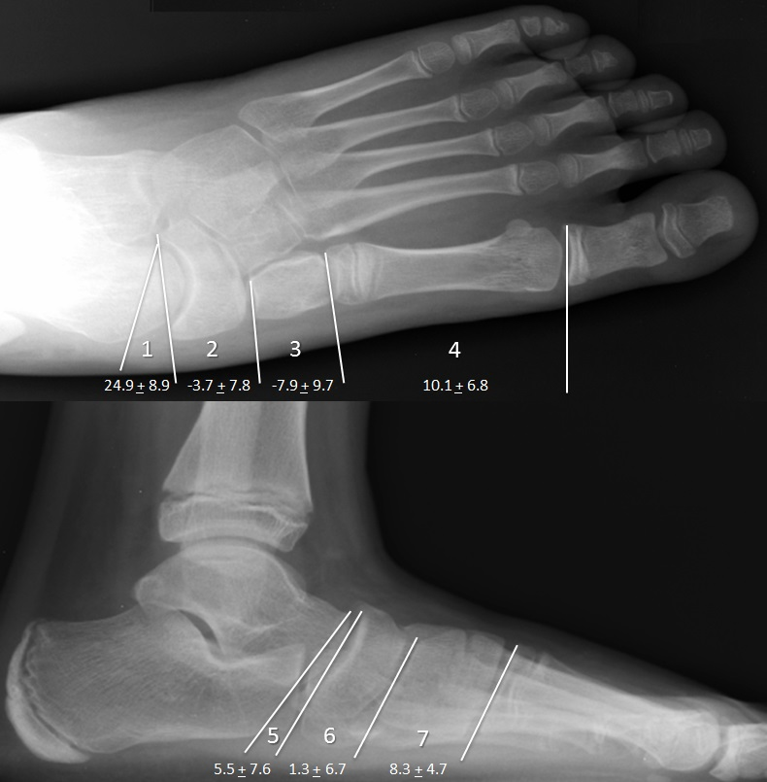
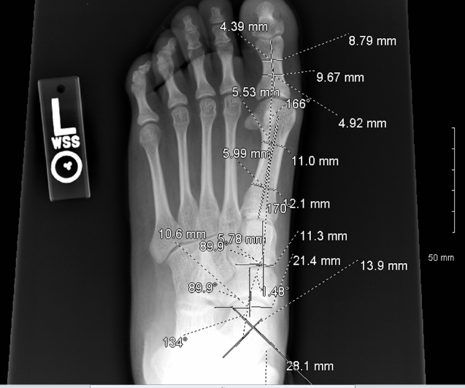
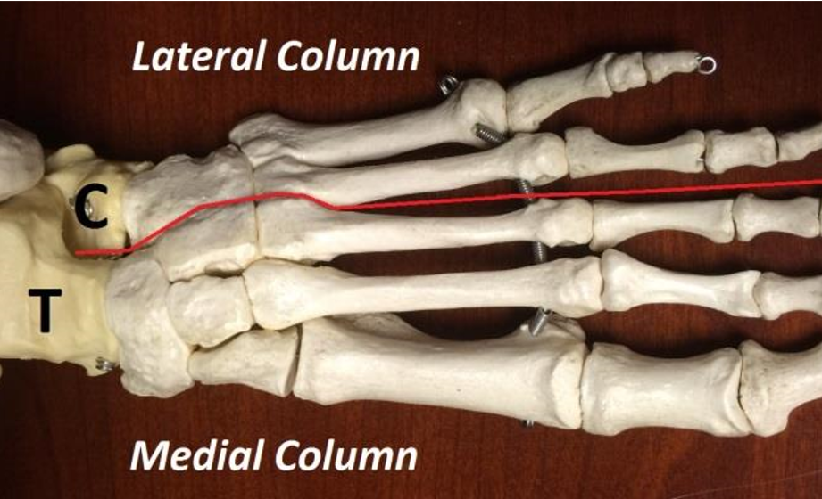


OBJECTIVE ASSESSMENT OF FOOT RADIOGRAPHS:
TECHNIQUE & NORMATIVE VALUES FOR THE MEDIAL COLUMN
V. Kulkarni MD, J. Friebele MD, K. Cruz BS, J. Boakes MD, A. Bagley PhD, J. Davids MD
Shriners Hospital for Children – Northern California, Sacramento, CA, USA; Valley Children's’ Hospital, Madera, CA, USA
INTRODUCTION
METHODS
Weight-bearing foot radiographs are critical to the understanding of foot deformity in children with cerebral palsy. A clinical model of the foot divides it into two “columns” [1]. The medial column consists of the talus, navicular, cuneiforms, and first through third metatarsals. The lateral column consists of the calcaneus, cuboid, and fourth and fifth metatarsals (Fig. 1).
Equinoplanovalgus foot deformity is among the most common foot deformities in cerebral palsy and is considered a functional shortening of the lateral column [2]. Surgical correction of this deformity by relative lengthening of the lateral column can dramatically improve foot alignment, but may unmask deformity of the medial column. Failure to recognize and address the medial column deformity may lead to incomplete correction or recurrent deformity, compromising the ultimate outcome of foot reconstruction. A technique for objective assessment of medial column segmental alignment of the foot has not been previously described.
Standing Anterior-Posterior (AP) and Lateral radiographs of 25 normal feet in 25 children (mean age 10.5 years) were analyzed. Seven measures of medial column segmental alignment were calculated utilizing a modified Cobb angle measurement of the articular surfaces at each bone (Fig. 2).
These measures included the following angles as numbered in Figure 3: 1) AP Talo-navicular, 2) AP naviculo-cuneiform, 3) AP Cuneiform-1st Metatarsal, 4) AP 1st Metatarsal-Proximal Phalanx, 5) Lateral Talo-navicular, 6) Lateral Naviculo-cuneiform, and 7) Lateral Cuneiform-1st Metatarsal. Intra- and inter-observer reliability was established by repeated measure of 10 feet by 2 surgeons utilizing intraclass correlation coefficients. Normative values for medial column alignment angles were calculated from 25 feet, utilizing mean and standard deviations.
Figure 2: Example of radiographic measurements in PACS.
Figure 3: Normative values for medial column segmental alignment. Values are shown as mean + standard deviation.
CONCLUSIONS
CLINICAL SIGNIFICANCE
The technique developed for objective radiographic assessment of medial column segmental alignment of the foot in children exhibited excellent reliability as measured by correlation coefficients. This quantitative assessment of medial column segmental alignment can be applied to the pre-operative assessment of foot deformity, intra-operative assessment of medial column deformity unmasked by lateral column lengthening, and post-operative assessment of foot alignment. Assessment of medial column foot alignment may improve mechanical foot modeling and outcome assessment
The goals of the current study were to develop and validate radiographic measures of medial column foot alignment and establish normative values.
Figure 1: The foot is divided mechanically into two columns. The medial column bones move with the talus (T), while the lateral column bones move with the calcaneus (C).
REFERENCES
RESULTS
Davids, JR. et al. Quantitative Segmental Analysis of Weight-Bearing Radiographs of the Foot and Ankle for Children. (2005) Journal of Pediatric Orthopaedics, 25(6):769-76.
Davids, JR. The Foot & Ankle in Cerebral Palsy. (2010) Orthopaedic Clinics of North America, 41: 579-593
Intra-observer reliability was excellent for 6 measures (0.81 to 0.95) and substantial for 1 measure (0.71 for lateral talo-navicular). Inter-observer reliability was excellent for 6 measures (0.84 to 0.98) and substantial for 1 measure (0.80 for AP naviculo-cuneiform). Normative values and standard deviations are shown below each angle in Figure 3. Positive values indicate valgus and planus, while negative values represent varus and cavus.
CONTACT
Vedant Kulkarni, MD: vkulkarni@shrinenet.org
F. Kamalei Cruz, BS: fkcruz@ucdavis.edu

